Slide 1
Rockbuster stealth case study
Austin Crehan

Slide 2
ROCKBUSTER STEALTH
Overview: You’ve been hired as a data analyst for Rockbuster Stealth LLC, a movie rental company that used to have stores around the world. Facing stiff competition from streaming services such as Netflix and Amazon Prime, the Rockbuster Stealth management team is planning to use its existing movie licenses to
launch an online video rental service in order to stay competitive.
Objective: Work with Rockbuster Stealth’s business intelligence team to launch a business strategy for their new online video service as they transition from traditional rental stores to an online video rental service.
DATA
TOOLS
SKILLS
Data loaded into RDMS and queried using PostgreSQL
Files include customer, inventory, and sales data
Data Dictionary
PostgreSQL
pgAdmin 4
Tableau
Working in relational databases
Database querying
Filtering databases
Joining tables
Subqueries and CTEs

Slide 3
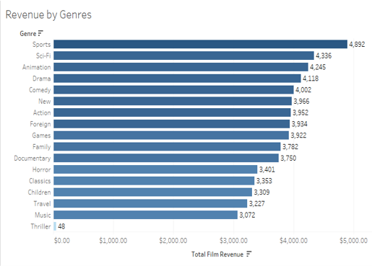
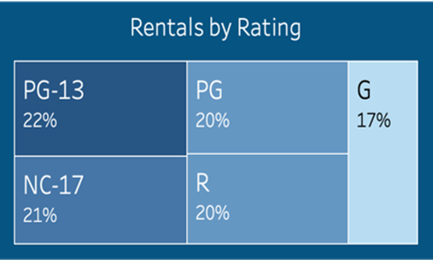
Analyzing movie popularity
Sports are by far the most popular genre followed by Sci-Fi and Animation
Music is the least popular genre
The bottom five genres (Horror/Thriller, Classics, Children, Travel, Music) experience a significant drop off from all other genres
Thriller data likely an outlier – could be included with Horror
The distribution is as expected – an almost even distribution across all ratings
There is a slight lean towards PG-13 (22%) and NC-17 (21%) ratings over G (17%) rating but not significant
Distribution of Rentals by Rating
Total Revenue by Genre

Slide 4
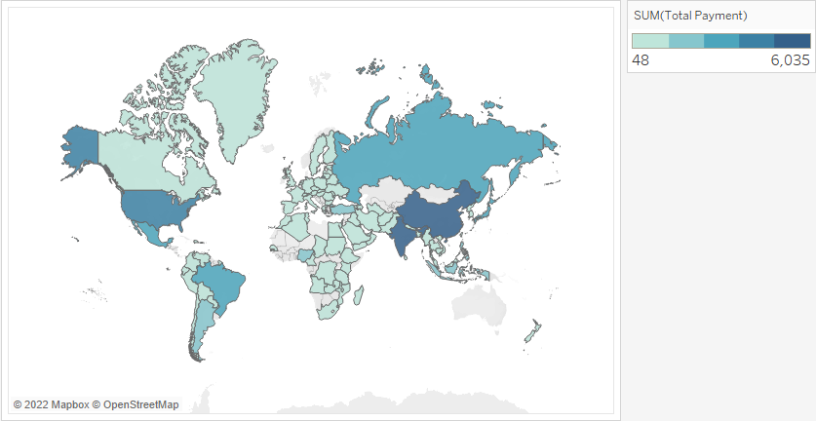
Analyzing a global customer base
Revenue by country
Customers come from all corners of the globe – over 90% of the world’s countries
With that said, three countries dominate in terms of revenue generated, India, China, and the United States

Slide 5
Rockbuster stealth recap
RESULTS
FURTHER ANALYSIS TO CONDUCT
Sports are by far the most popular genre followed by Sci-Fi and Animation
Music is the least popular genre
There is a slight lean towards PG-13 (22%) and NC-17 (21%) ratings over G (17%) rating but not significant
Three countries dominate in terms of revenue generated, India, China, and the United States
If we increase the inventory of the most popular genres and decreases the inventory of the least popular genres, would that drive profit growth? Should we get more PG-13 and NC-17 rated movies and fewer G rated movies?
How can we expand in countries that we offer services in but currently are generating low revenue? Could we introduce focused marketing campaigns in those countries?
LINKS
Github
Presentation

